Slide 1
Food Connect: Social Networking Website for Food Lovers
Project Advisor: Prof. Andrew Bond
Team Members: Ananth Upadhya
Deesha Desai
Preeti Parihar
Priyanka Devendran

Slide 2
Problem Statement
Lack of trusted reviews in existing online food ordering platforms
In-ability to track the restaurants visited
Lack of personalized restaurants and friends recommendation
Inability to connect with friends
Inability to plan for a restaurant visit along with friends on existing platforms

Slide 3
What is Food Connect?
A social networking platform for foodies
Ability to track the restaurants visited
Review and Rate restaurants visited
Ability to connect with friends
Personalized restaurants recommendation
View reviews and ratings given by friends
Friend recommendation based on similar interests

Slide 4
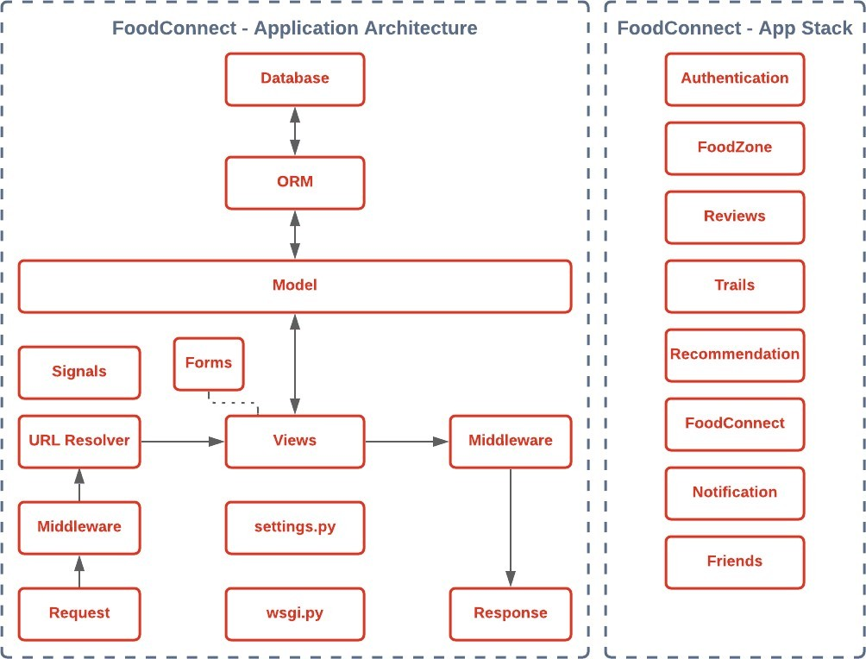
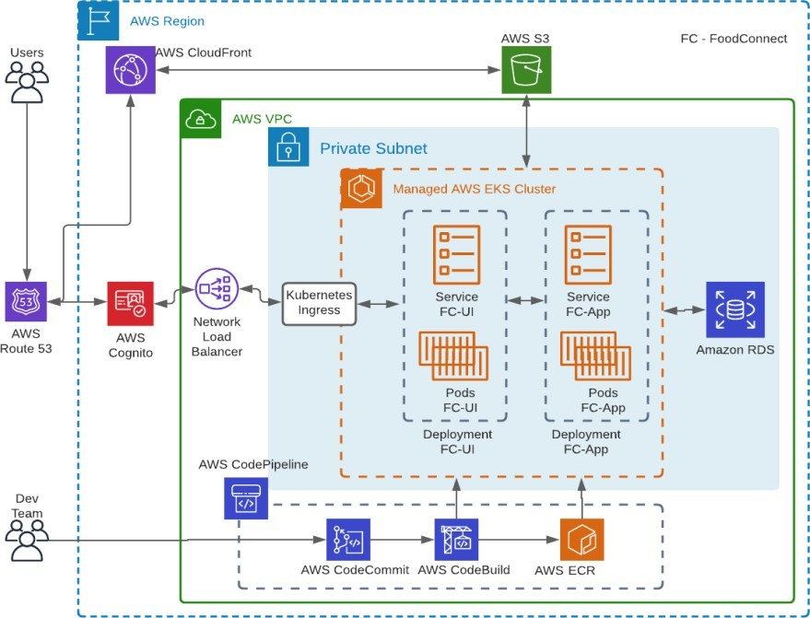
Design and Architecture
Application Architecture
Deployment Architecture

Slide 5
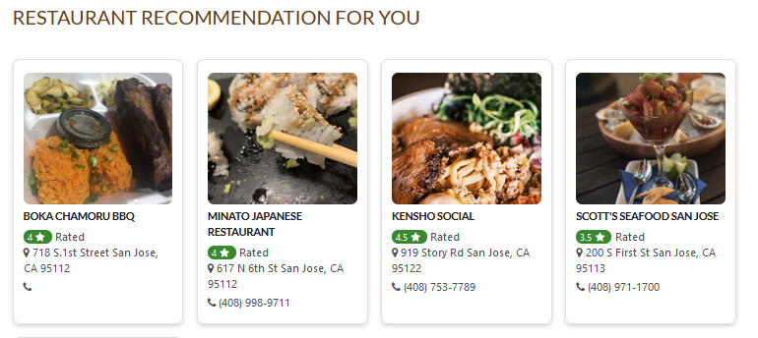
Recommendation System
Restaurants

Slide 6
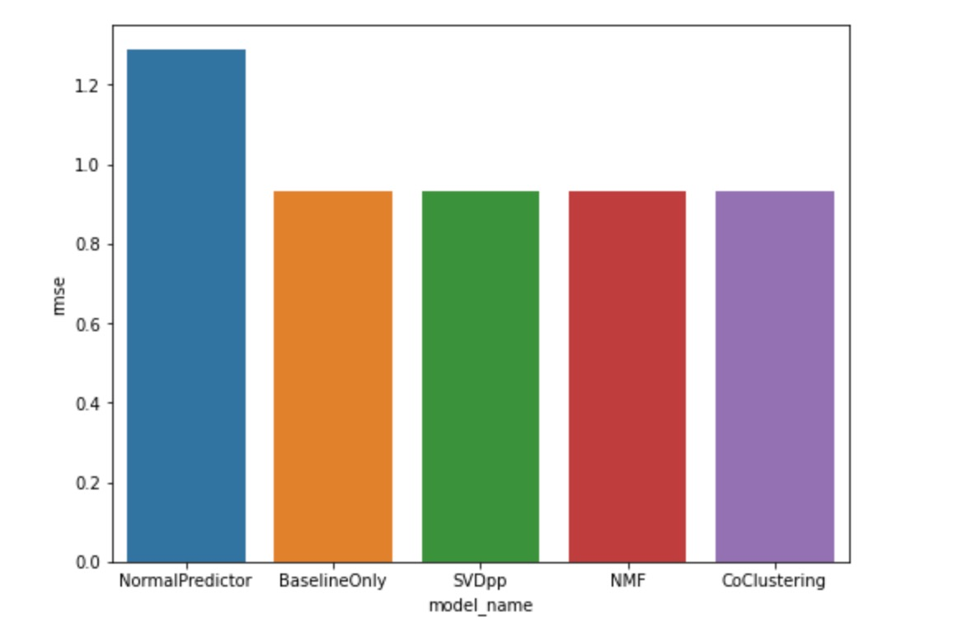
Item-User collaborative filtering
A user-item filtering takes a particular user, find users that are similar to that user based on similarity of ratings, and recommend items that those similar users liked.

Slide 7
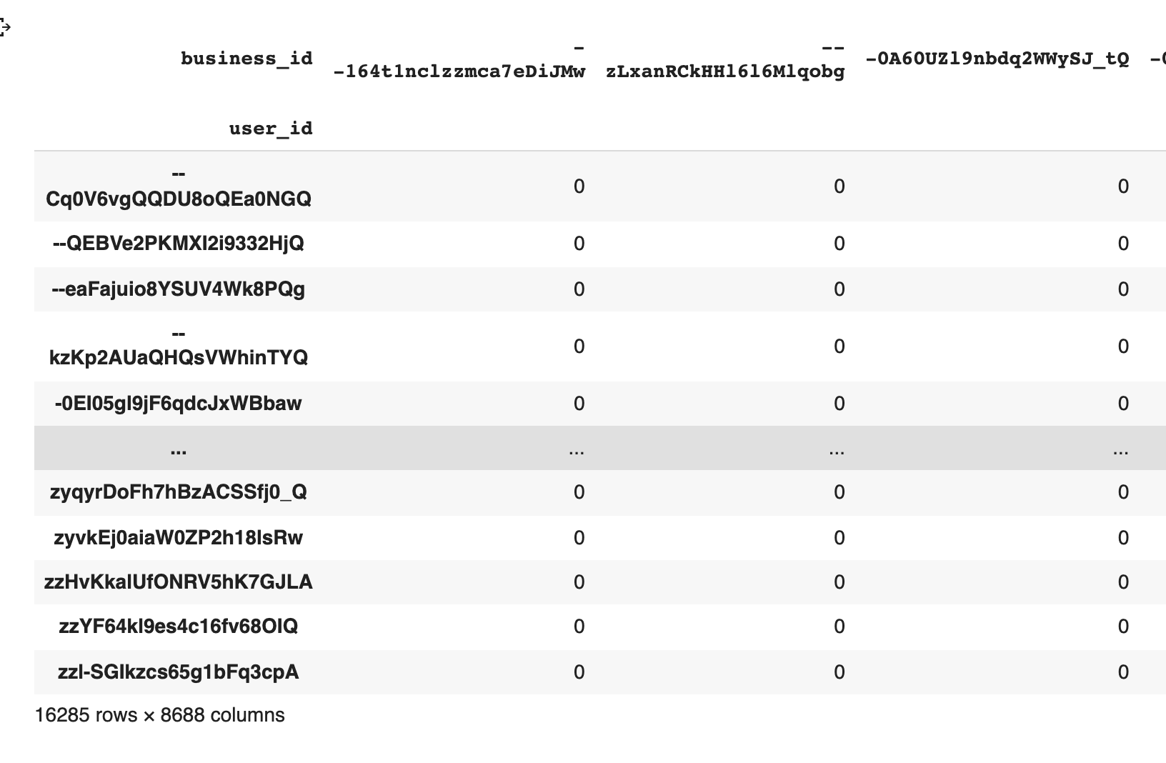
Item-Item Collaborative Filtering
In this type of recommendation system input is a restaurant(ITEM) and recommendation is a List of recommended restaurants(ITEM).
Notes:
For this, we need to have pivoted table. Rather than having user-restaurant-rating we need to have a matrix structure, in which all the restaurants are rows, all the users are columns, and value is the rating as below
As it is evident that many users might not have visited many restaurants, we will be having a majority of 0’s which don’t carry useful information. Hence this matrix is condensed into a sparse matrix. We have utilized the SciPy library to get the sparse matrix.
After this using the KNN algorithm we can suggest the N nearest restaurants for the supplied restaurants. The KNN algorithm is as on need basis.
Using the Sparse Matrix, and KNN Machine learning model restaurants can be recommended. This is usually the best way to recommend in classical machine learning when we have new users coming up in the system and hence this is the process we have used in our application.

Slide 8
Future Work
FoodConnect chat, that enables users to instantly message multiple friends directly through the website.
Send out request to friend’s to try out the user’s favourite restaurants.

Slide 9
Thank You!!!

